Slide 1
Chapter 2
Business Processes, Information Systems, and Information

Slide 2
“I Got the Email, But I Couldn’t Download the Attachment.”
Difficult for everyone to attend meetings
Wasting time covering old ground
Cell phone calls interrupt meeting
Felix not reading meeting minutes
Interpersonal conflicts
Getting snippy, feelings being hurt
“Let’s just ignore Felix”
Felix opposes project, not really participating
Notes:
Group needs better communication.
Illustrates a dysfunctional meeting.
Show some of the disadvantages of face-to-face meetings.
Show some of the disadvantages of a group’s use of email.
Show behavior of disinterested group member.
Look at the statements and behaviors of Felix. It appears he is disassociated from the group. Have the class identify those clues. Downloading an attached Word or pdf isn’t complicated. So, did Felix really try? If he had a problem downloading the file, why didn’t he try to solve it?

Slide 3
Study Questions
Q1: Why does the Falcon Security team need to understand business processes?
Q2: How can business process modeling help organizations?
Q3: How can information systems improve process quality?
Q4: What is information?
Q5: What data characteristics are necessary for quality information?
How does the knowledge in this chapter help you?
Notes:
Chapter investigates ways information systems can support collaboration. It defines collaboration; discusses collaborative activities and criteria for successful collaboration; discusses kinds of work collaborative teams do, requirements for collaborative information systems; and discusses important collaborative tools for improving communicating content. The chapter ends with a discussion of collaboration in 2026!

Slide 4
Q1: Why Does the Falcon Security Team Need to Understand Business Processes?
For informed, effective discussions and evaluations
Create abstraction or model of Falcon's current processes
Identify new business processes and information systems to support drone production
Determine if savings justify changing business processes
Notes:
Mateo's concerns are legitimate. Changing Falcon Security from a company that buys drones to a company that makes drones would be a big change. It would change not only what the company does but how the company does it, too.

Slide 5
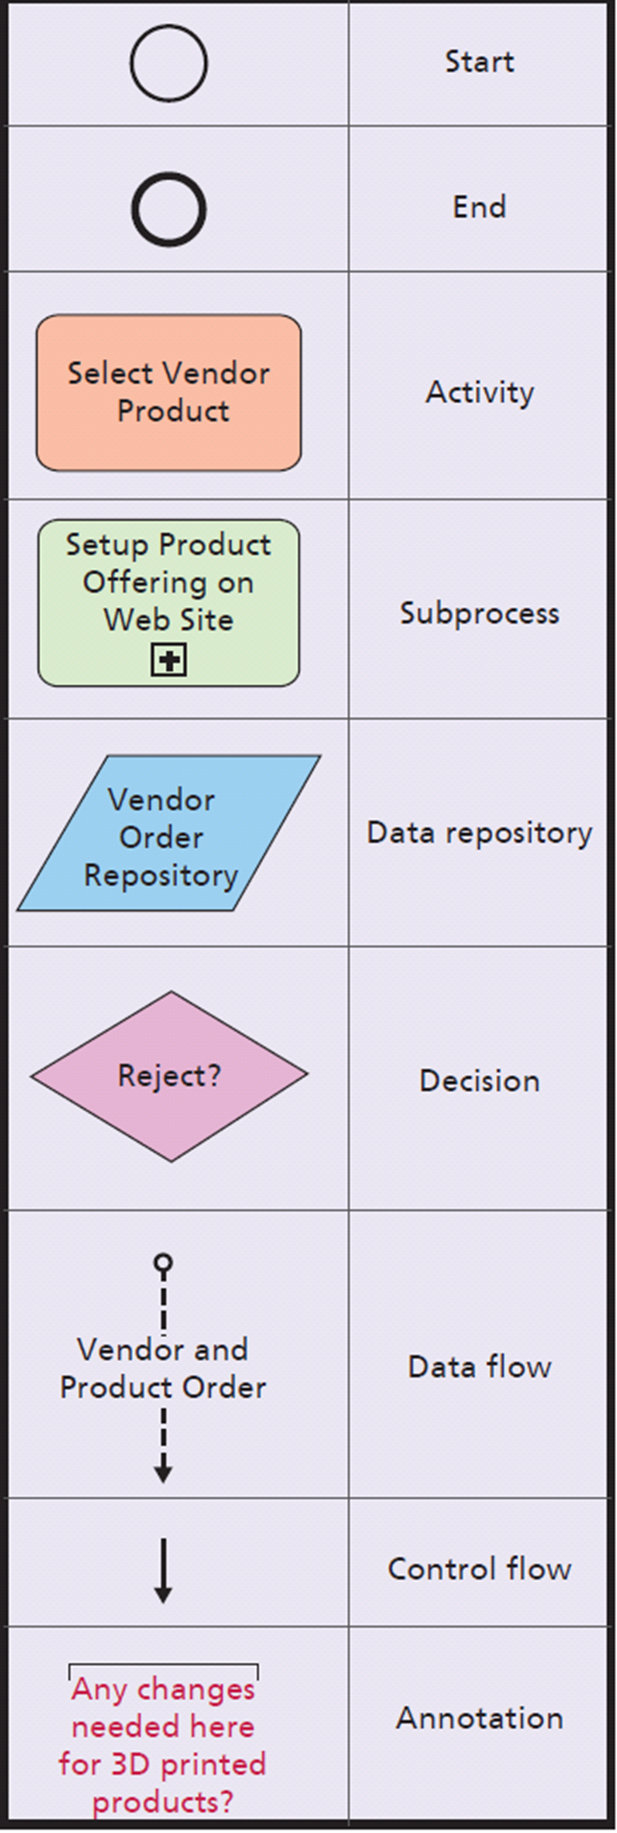
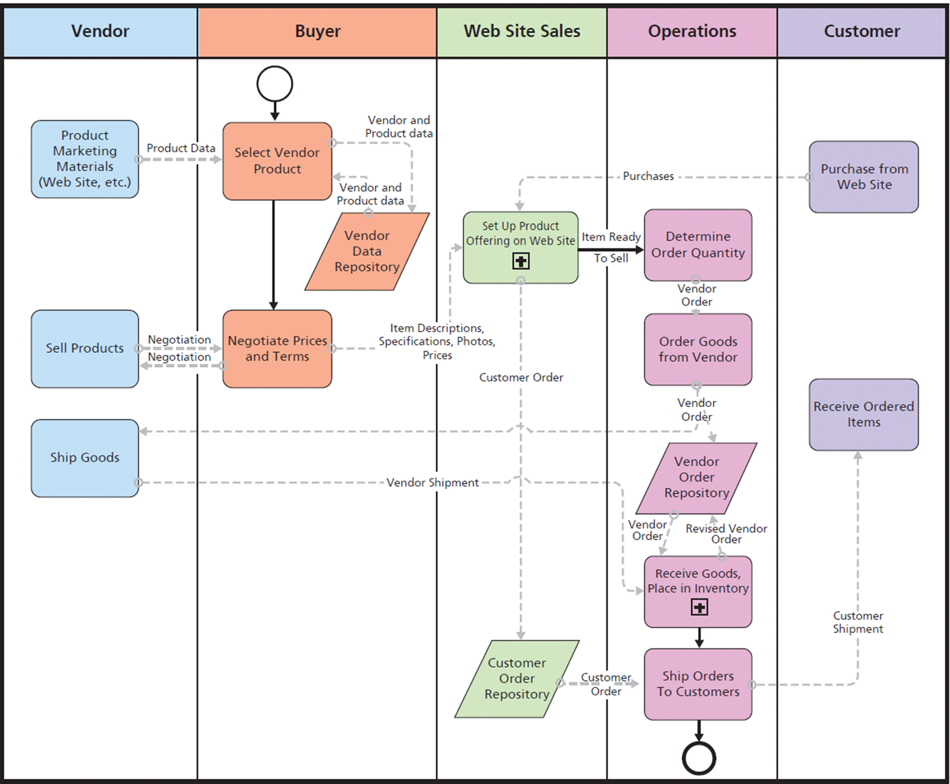
Q2: How Can Business Process Modeling Help Organizations? (Best Bikes example)
Swimlane format
Notes:
Figure 2-1 is a business model of a hypothetical online bicycle part retailer named Best Bikes. We will show how to create an abstraction of Best Bikes' basic business processes, then how these processes could be modified if the company decided to 3D-print its own parts rather than buying them from its parts suppliers.
Note there are two vendor data repositories: one used by Buyers to select vendors, the other used by Operations to store order data.

Slide 6
How Best Biked Processes Must Change to Support 3D Printing
Operations will need to decide whether to 3D print a part manufactured in-house
Uses process diagrams to communicate process structure and possible changes, additional personnel needs
Notes:
Best Bikes considering 3D printing its own parts in an effort to reduce costs and carry a large selection of parts. Notice the single data repository share by Buyer and Operations.
New role for 3D printing added. Operations needs to decide whether to manufacture in-house using 3D printing.
Process diagrams provide means to communicate with others about process structure and possible changes.

Slide 7
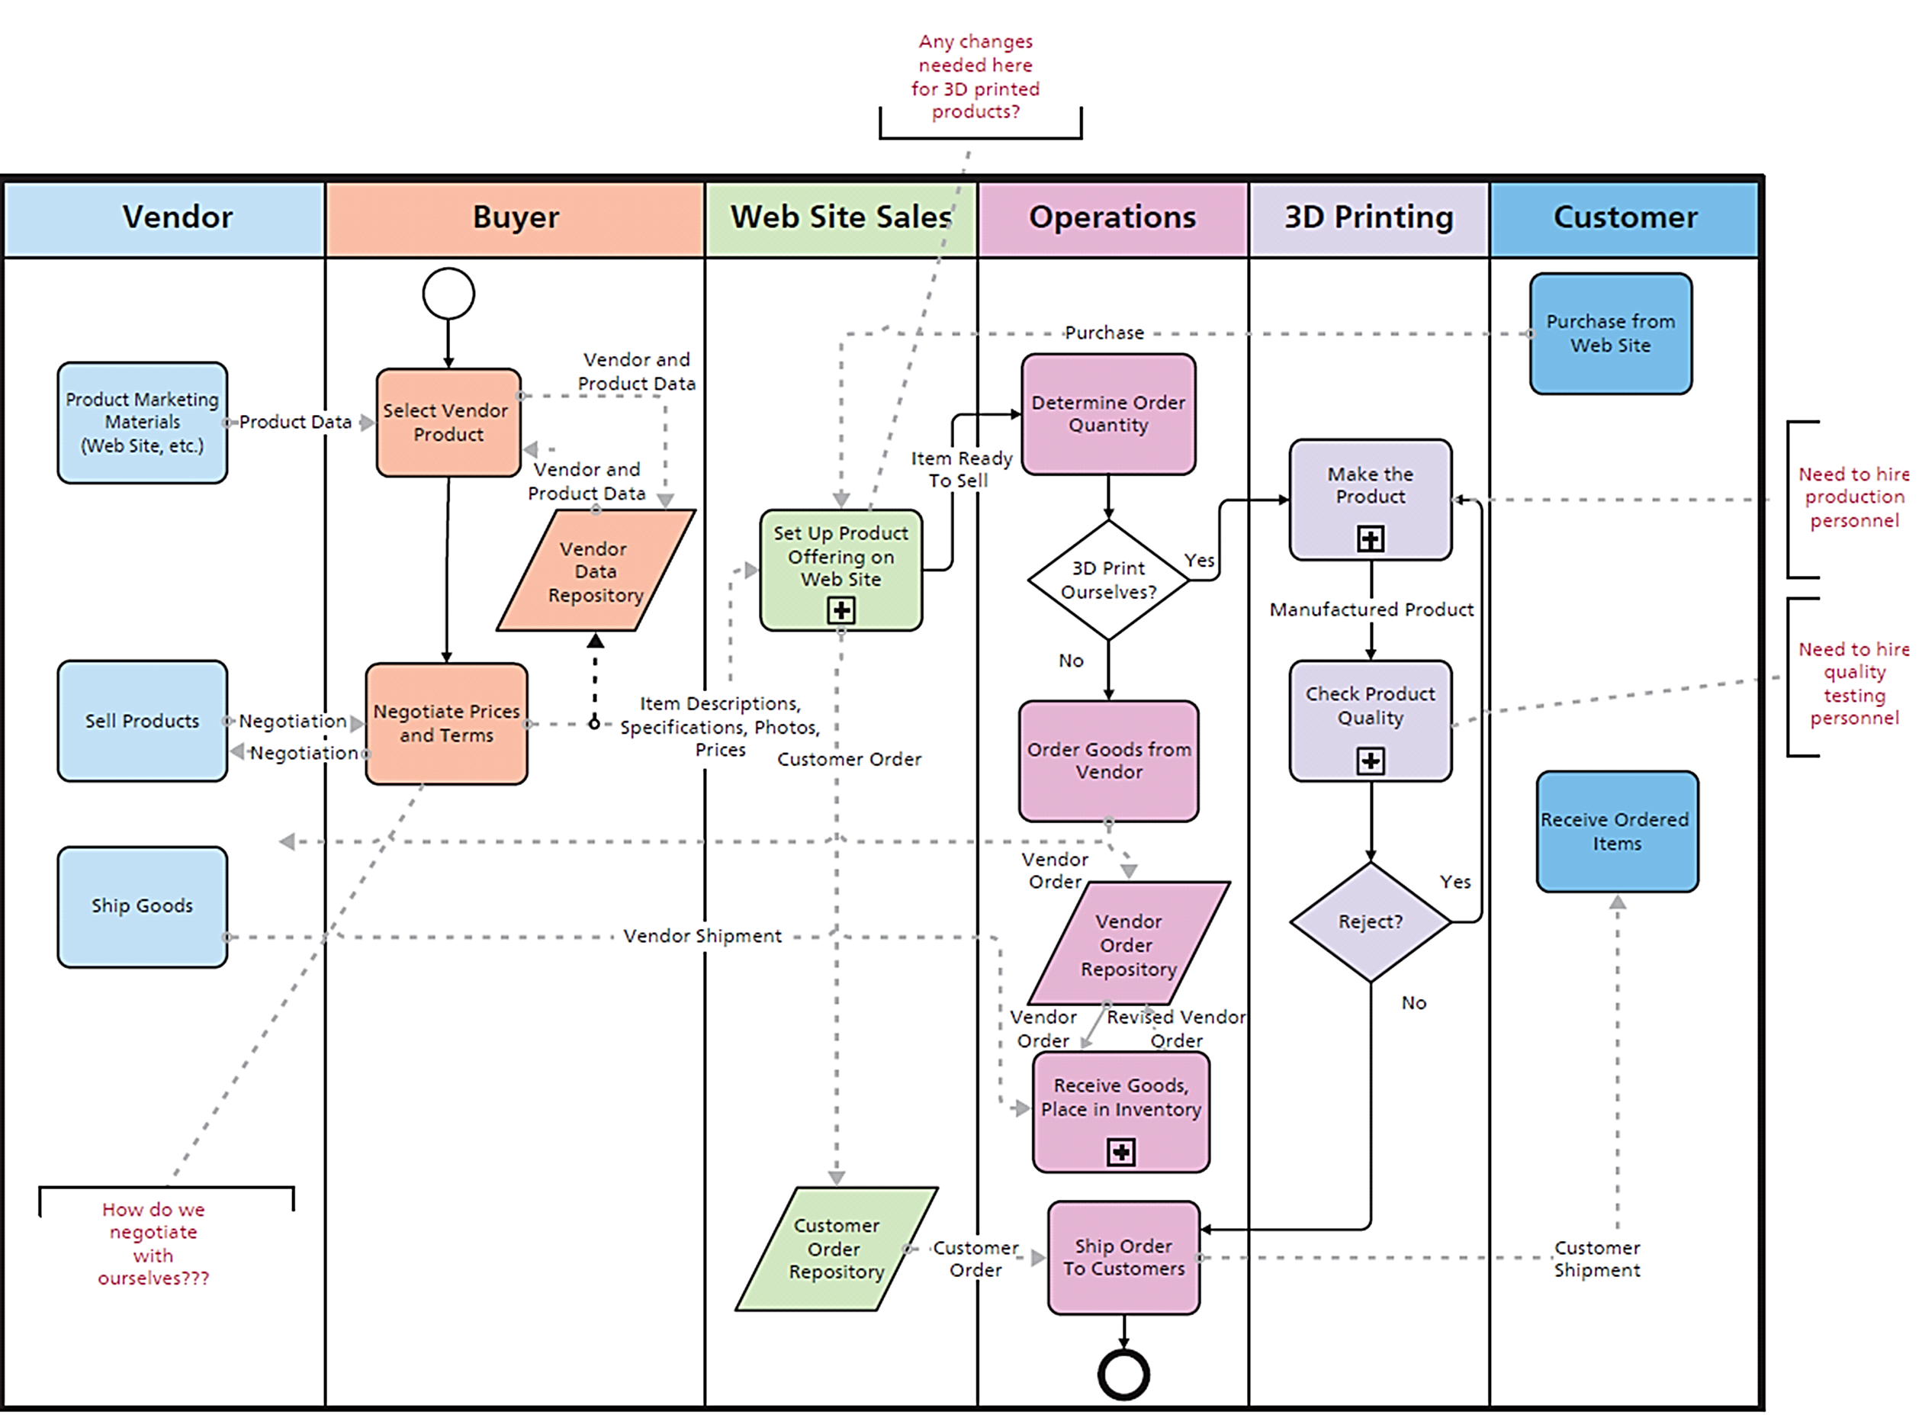
Revised Best Bikes’ Processes Using BPMN
Notes:
Figure 2-3 shows need to further define the subprocesses Make the Product and Check Product Quality.

Slide 8
Q3: How Can Information Systems Improve Process Quality?
Current processes do not support 3D printing
Dimensions of process quality
Efficiency -> ratio of benefits to costs
Effectiveness -> enables organization to accomplish strategy
Figure 3-1, two vendor data repositories
Single repository less costly, generate fewer errors, and as effective
Notes:
One element of Best Bikes' strategy is to have the largest selection of parts in the industry. It is investigating whether 3D printing will help accomplish that strategy.

Slide 9
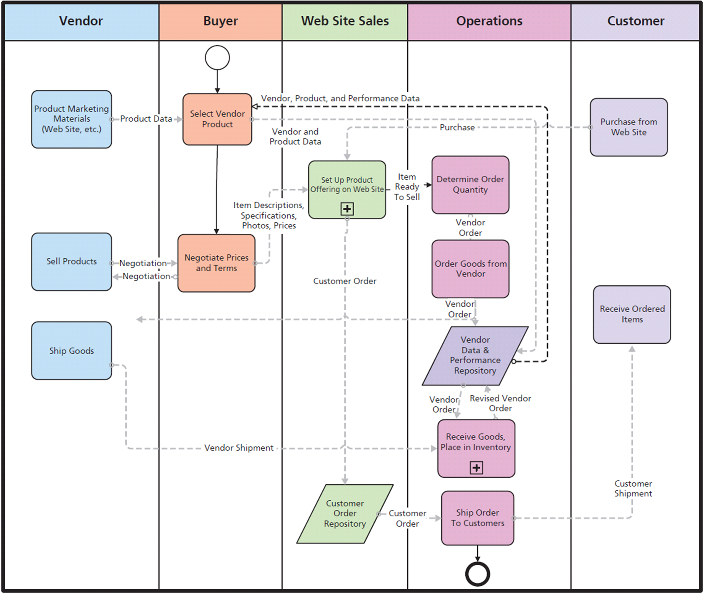
Falcon Security Business Process with Single Vendor Repository
Notes:
Costs not directly. One major source is labor cost labor to perform process activities.

Slide 10
Process Costs
BPMN doesn't show costs directly
Cost is labor to perform activity
Computer network, email, or other system needed to support data flows
Cost of infrastructure part of business process costs. Use an Information System to Store Vendor Data
Notes:
There are infrastructure costs to consider because computer network, email, or other systems are needed to support the data flows.

Slide 11
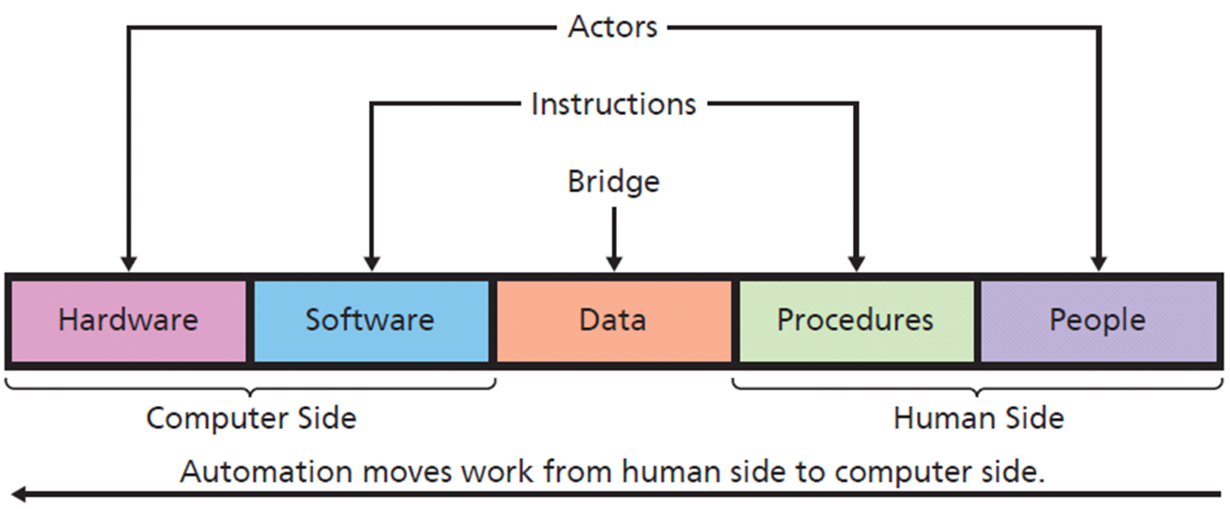
Using Information Systems to Improve Process Quality
Notes:
Notice symmetry of components. Outermost, hardware and people are actors that perform action.
Software and procedure components are sets of instructions. Software is instructions for hardware and procedures are instructions for people.
Data is the bridge between computer side and human side.
Discuss examples of automation, such as capturing Vendor data and performance data.

Slide 12
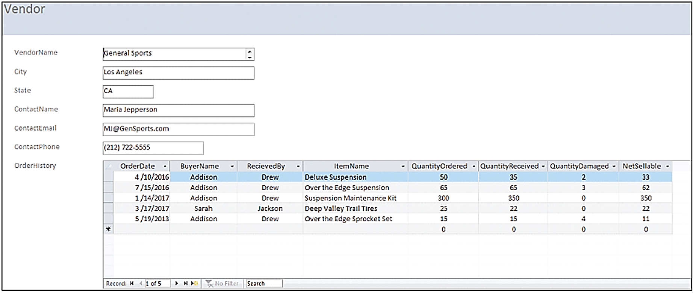
Falcon Security Data on General Sports
Notes:
Consider performance data in Figure 2-6. General Sports frequently ships fewer items (Quantity Received) than requested (Quantity Ordered), and in one case, it shipped too many parts. In addition, Falcon Security received many items in damaged condition.
This information makes Falcon Security’s buying process more effective.
Storing Vendor Product and Performance Data in one Database improves efficiency and effectiveness.

Slide 13
Q4: What Is Information?
Definitions vary:
Knowledge derived from data, where data are recorded facts or figures
Data presented in a meaningful context
Processed data, or data processed by summing, ordering, averaging, grouping, comparing, or other similar operations
A difference that makes a difference
Notes:
Data: each employee's hourly wage.
Information: average hourly wage; graphic comparison of stock price to net income.

Slide 14
Where Is Information?
Graph is not, itself, information
Graph is data you, and others, use to conceive information
Ability to conceive information from data determined by cognitive skills
People perceive different information from same data
Notes:
Does a graph contain information? If it shows a difference that makes a difference or if it presents data in a meaningful context, then it fits two of the definitions of information, and it’s tempting to say the graph displays information.
However, show that graph to your family dog. Does your dog find information in that graph?

Slide 15
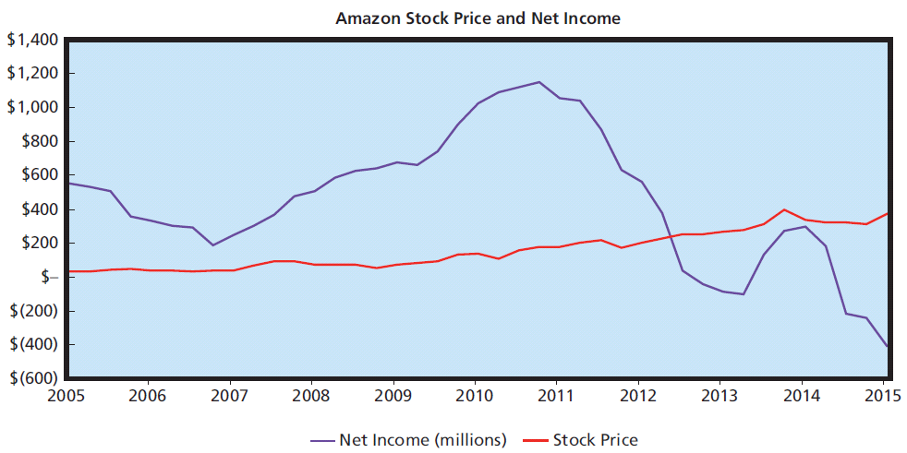
Does this Graph Contain Information?
Notes:
This graph is data that you and other humans perceive, and from that perception you conceive information.

Slide 16
So What? Augmented Collaboration
How can HoloLens change collaboration and business?
Identifying industries that might benefit from augmented reality technology. How so?
What is the difference between the Oculus Rift and the Microsoft HoloLens?
How could this type of technology benefit students?
What about privacy concerns?

Slide 17
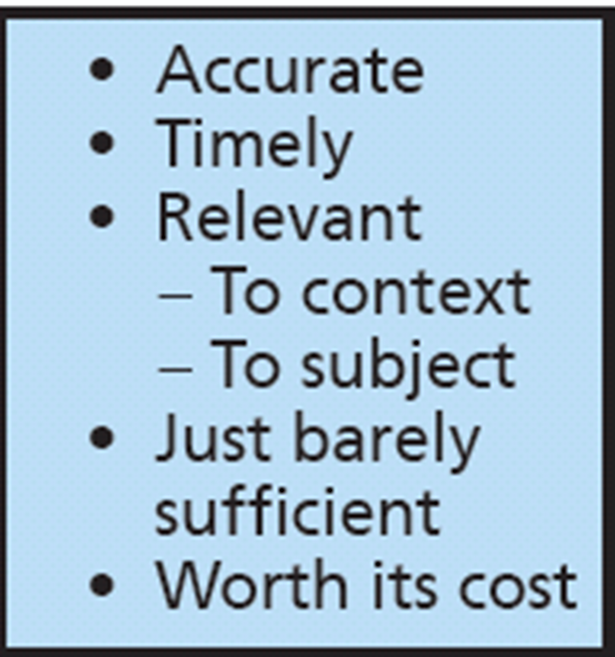
Q5: What Data Characteristics Are Necessary for Quality Information?
Notes:
Example of poor information--data in Figure 2-6 is incorrect, there is no way buyers can make good decisions about parts procurement.

Slide 18
How Does the Knowledge In This Chapter Help You?
Helps you by:
Enabling you to communicate effectively with IS professionals and colleagues
Demonstrating your ability to use systems thinking, abstraction, collaboration and experimentation skills
Enabling you to document business processes
Furthering your career prospects

Slide 19
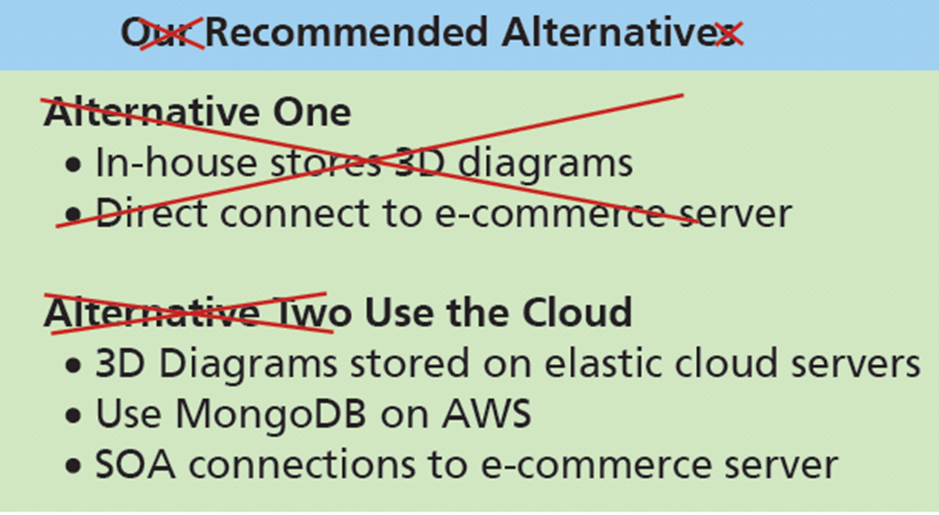
Ethics Guide: I Know What’s Better, Really
You believe that Alternative Two is vastly preferable
Leslie believes Alternative One is better
Notes:
GOALS
Introduce a second perspective for assessing the ethics of behavior: utilitarianism.
Ask students to assess the ethics of taking advantage of a co-worker’s absence.
Compare and contrast the results of two different ethical perspectives.

Slide 20
Ethics Guide: I Know What’s Better, Really (cont'd)
You and co-worker develop two different alternatives for consideration
Leslie will miss meeting due to family emergency
You believe Leslie's plan (Alternative One) could cause irreparable harm to company, and your plan is better
You present your plan (Alternative Two), but not Leslie's
You lead committee to think Leslie supports your plan

Slide 21
Ethics Guide: I Know What’s Better, Really (cont'd)
Committee adopts your plan and Leslie never learns committee never saw her plan
Was your behavior ethical?
Categorical imperative - What you ought to do, independent of your own wants
Utilitarianism - Morality of an act is determined by its outcome
Notes:
According to utilitarianism, is your action not to present Leslie’s alternative ethical?

Slide 22
Ethics Guide: Egocentric vs. Empathetic Thinking
Egocentric thinking
Centers on self
“I’m right, everyone else is wrong.”
Empathetic thinking
“My View” is one possible interpretation
Take time to learn perspective of others
Take time to understand problem domain as a system
Notes:
Raise the level of professionalism in the class.
Explore empathetic thinking and discuss why it’s smart.
Discuss two applications of empathetic thinking.
Emphasize that a problem is a perception and that perceptions differ among people.
Discuss that different problem perceptions require different information systems.

Slide 23
Ethics Guide: Egocentric vs. Empathetic Thinking (summary)
Consider Falcon Security:
Interpersonal conflicts
Getting snippy, feelings being hurt
“Let’s just ignore Felix”
Felix opposes project, not really participating
Felix doesn’t come to meetings
Felix thinks team is focused on drone flight performance
Alexis thinks team should determine drone parts to be 3D-printed
Notes:
Imagine yourself in that meeting. If everyone engages in egocentric thinking, what will happen? The meeting
will be argumentative and acrimonious and likely will end with nothing accomplished.

Slide 24
Active Review
Q1: Why does the Falcon Security team need to understand business processes?
Q2: How can business process modeling help Falcon Security?
Q3: How can information systems improve process quality?
Q4: What is information?
Q5: What data characteristics are necessary for quality information?
How does the knowledge in this chapter help you?
Notes:
Chapter investigates ways information systems can support collaboration. It defines collaboration, discusses collaborative activities and criteria for successful collaboration. Discusses kinds of work collaborative teams do, requirements for collaborative information systems, important collaborative tools for improving communicating content. Three different collaboration IS are presented for student collaborations. Chapter ends with a discussion of collaboration in 2025!

Slide 25
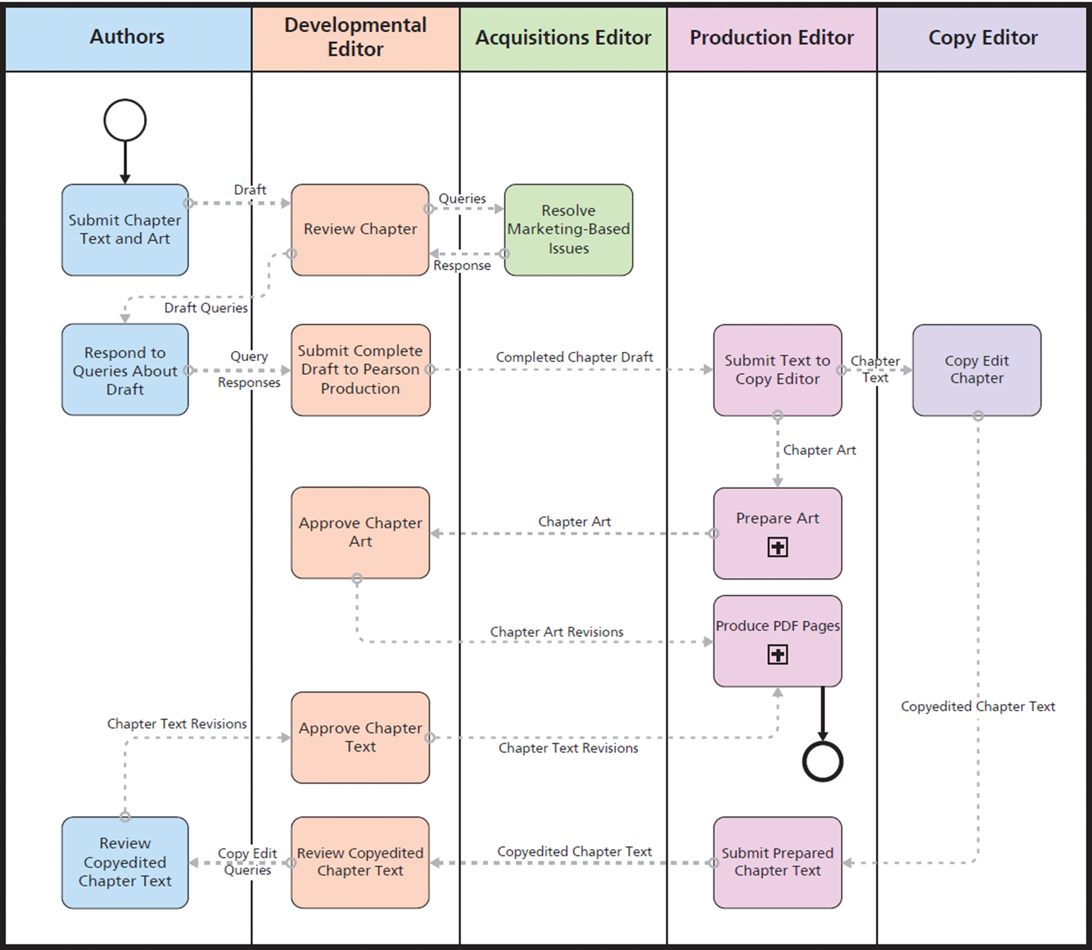
Case Study 2: Eating Our Own Dog Food: Chapter Development Process
Notes:
This is a diagram of the chapter development process that transforms a draft chapter in Word, PowerPoint, and PNG image format into PDF pages. This text was developed by a collaborative team, using Office 365.

Slide 26
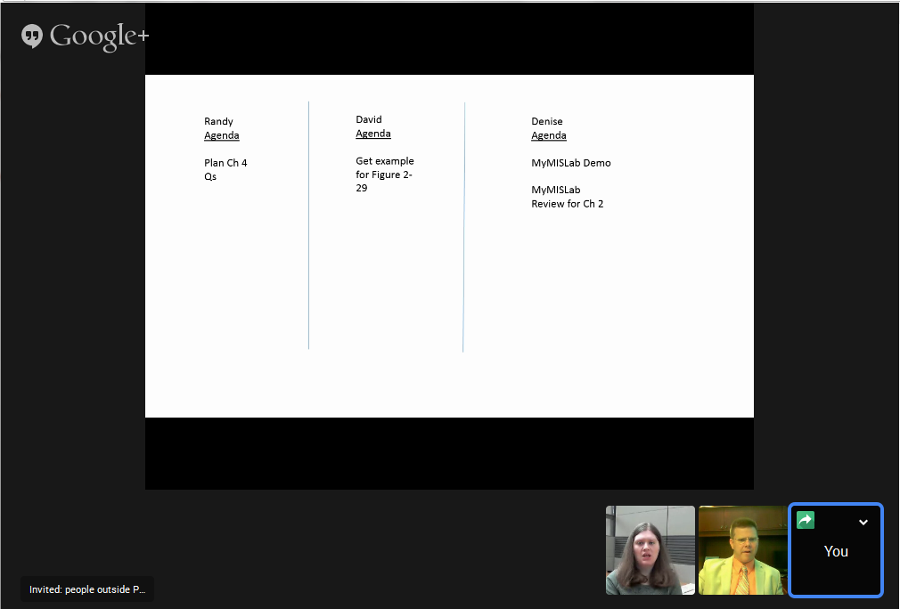
Case Study 2: Eating Our Own Dog Food (cont’d)
Notes:
This slide shows a Google Hangout group conversation.
Notice three participants sharing a common whiteboard. Each can write or draw on whiteboard. At end of meetings, whiteboards were saved and placed on team’s SharePoint site to be used as meeting minutes.

Slide 27
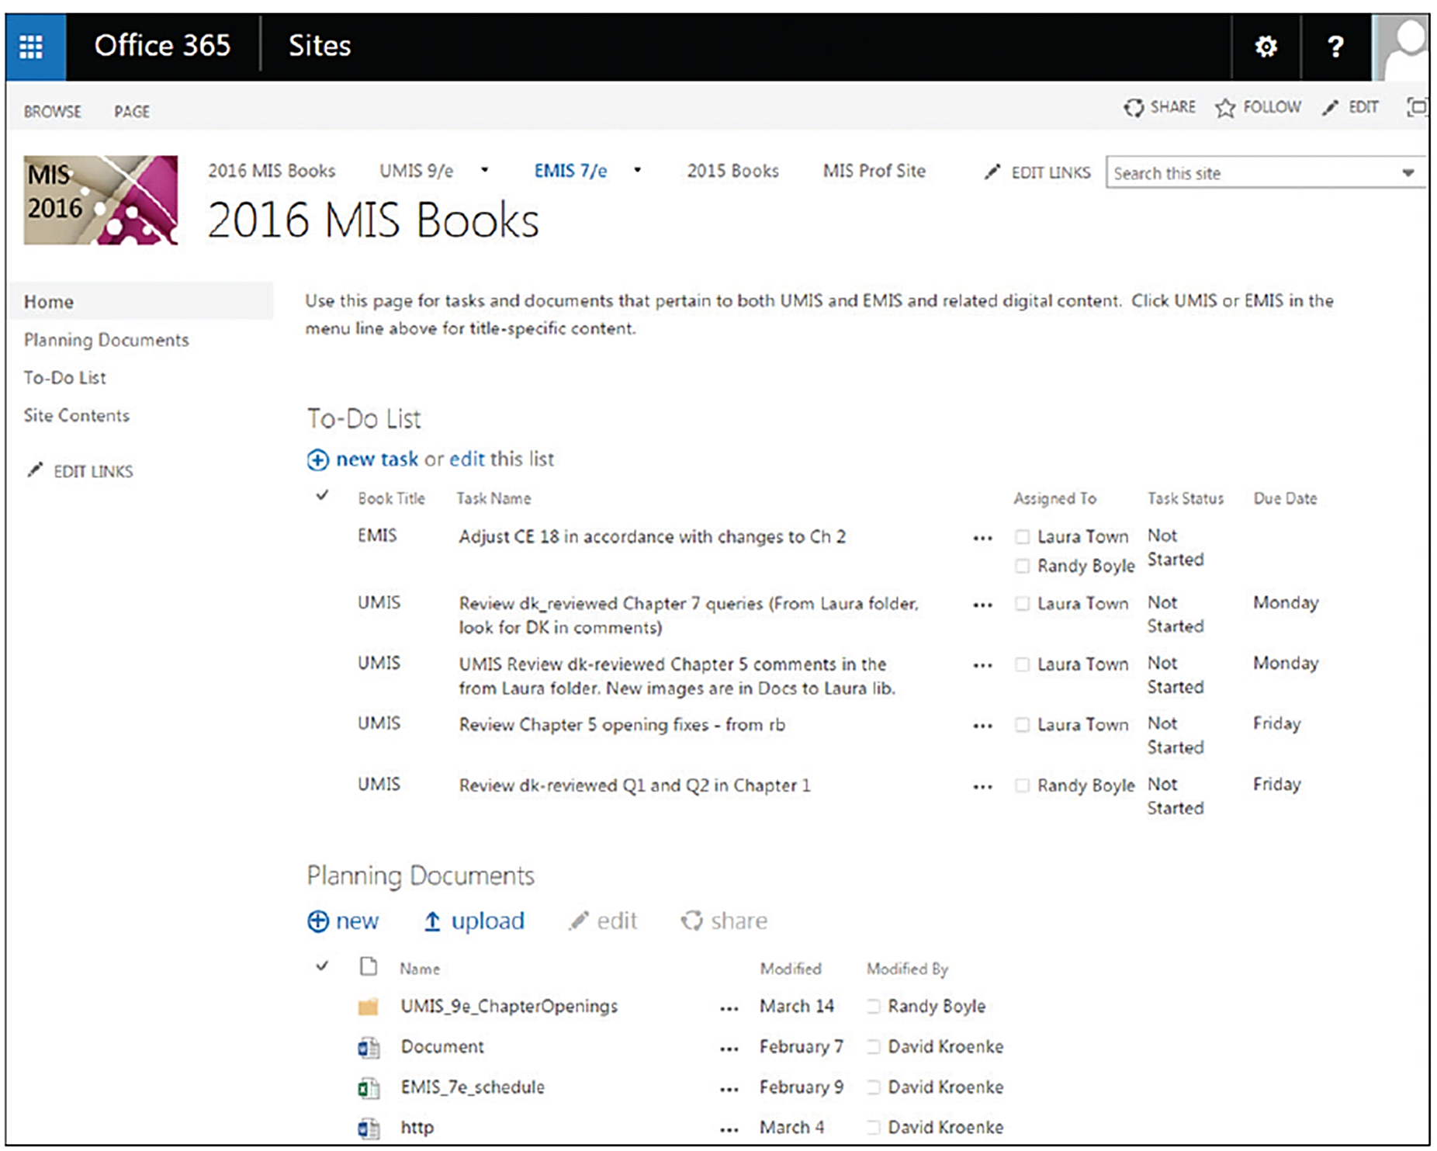
SharePoint Development Site

Slide 28
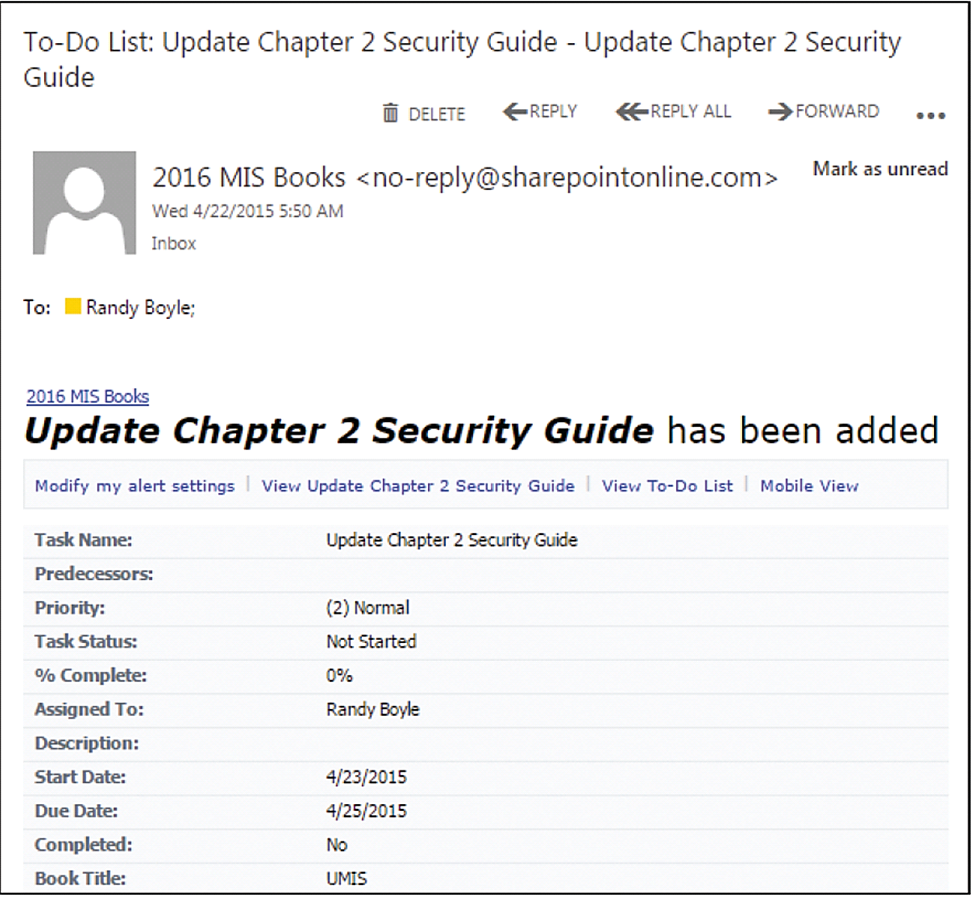
Example Email from SharePoint

Slide 29
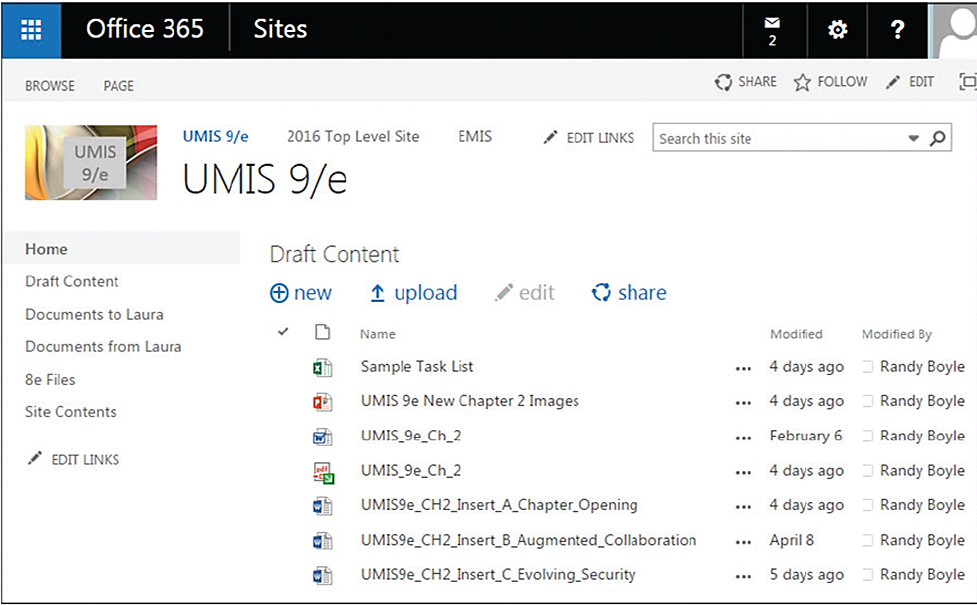
First Draft Document Library Contents

Slide 30
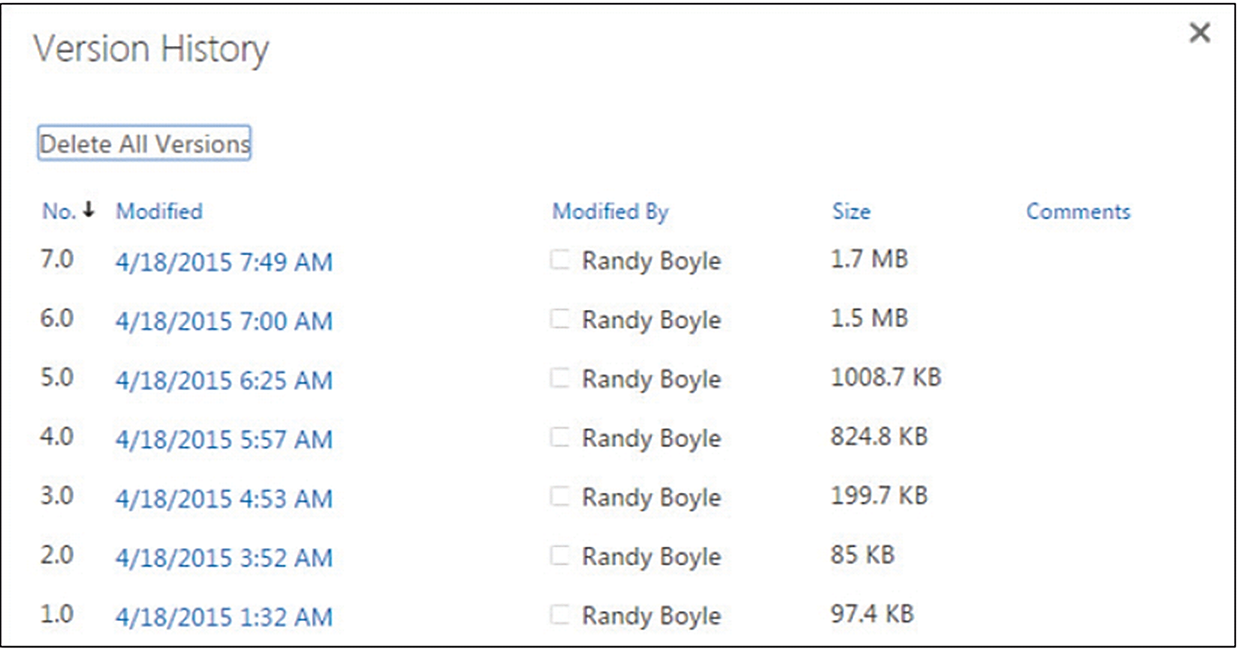
Chapter 6 Version History

